Slide 1

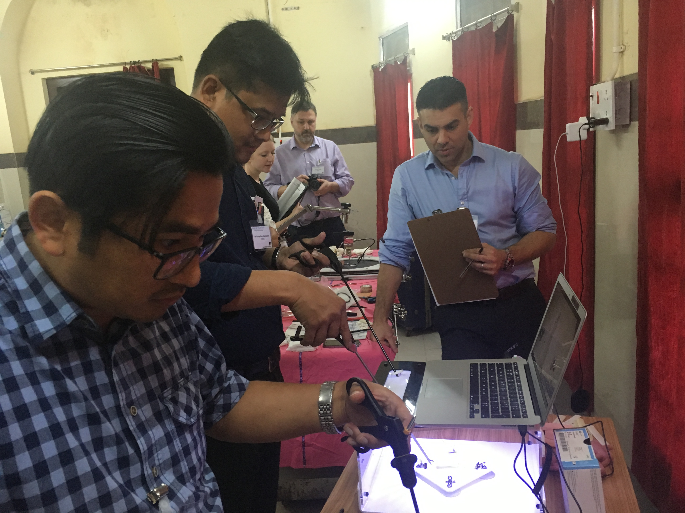

PROJECT GILLS
GILLS INTRODUCTION COURSE
3 Day workshop
Didactic lectures, videos, training on simulators, training with equipment
Certificate from MLCU, ARSI & IFRS
Low cost Lap Pack from University of Leeds
RURAL UROLOGY
RURAL UROLOGY
ASSOCIATION OF RURAL SURGEONS OF INDIA

Slide 2
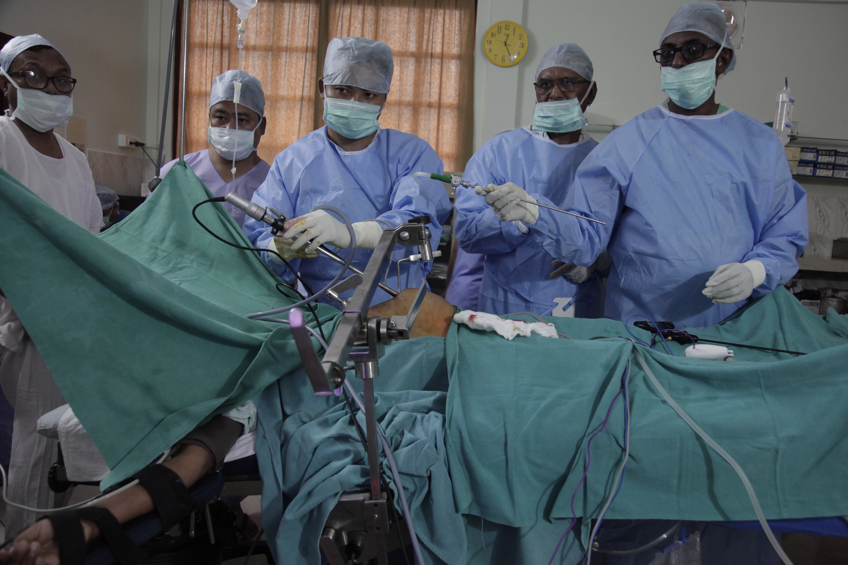
PROJECT GILLS
GILLS BASIC LEVELCERTIFICATE COURSE
7 Day workshop at authorized centers
Proctorship at the Trainees Centers
Certificate from MLCU, ARSI & IFRS
Examination & Certification by MLCU
GILLS Equipment set
Training in Laparoscopy diagnosis and minor procedures
RURAL UROLOGY
RURAL UROLOGY
ASSOCIATION OF RURAL SURGEONS OF INDIA

Slide 3
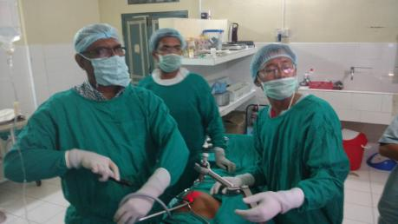
PROJECT GILLS
GILLS ADVANCED LEVEL FELLOWSHIP COURSE
7 Day workshop at authorized centers
Proctorship at the Trainees Centers
Certificate from MLCU, Fellowship from ARSI & IFRS
Examination & Certification by MLCU
GILLS Equipment set
Training in advanced laparoscopic surgeries
RURAL UROLOGY
RURAL UROLOGY
ASSOCIATION OF RURAL SURGEONS OF INDIA

